Slide 1
Considerations on Inter-DC Collective Communication Optimization(CCO)
IETF 120
Kehan Yao, China Mobile

Slide 2
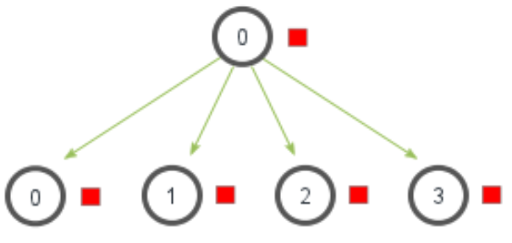
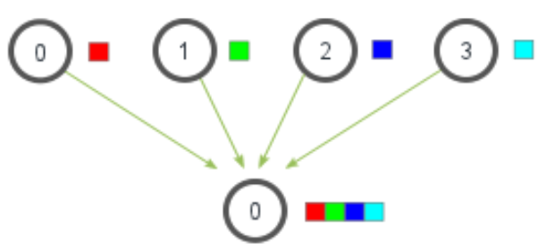
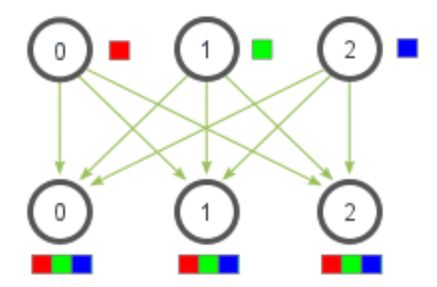
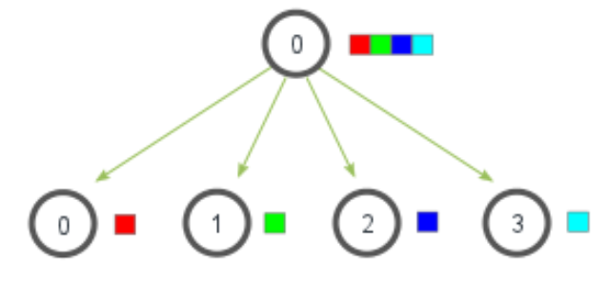
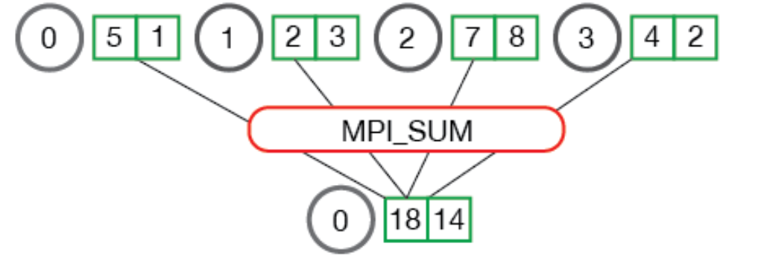
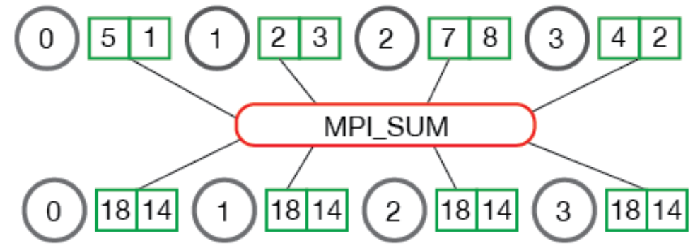
Collective Communications
Collective communication: A set of communication patterns that application processes follow to communicate with each other in a parallel computing cluster. These patterns include One-to-Many, Many-to-one, or Many-to-Many delivery mode.
Collective Broadcast()
Collective Gather()
Collective Allgather()
Collective Scatter()
Collective Reduce()
Collective Allreduce()

Slide 3
Factors should be taken into account for CCO
Parallism strategies
DP, MP, PP, and MoE
Topologies
High capacity Clos or Dragonfly.
Transport related issues
Flow control: CBFC, PFC
Retransmission: go-back-N or selective?
Data Input Method
Pull: need at least 1-RTT for initialization, high latency but good reliability.
Push: 0-RTT initialization, low latency but not reliable, need careful design of flow control.
Data Synchronization
very important for some collective operations, for example, Allreduce, for computation correctness.
Error Recovery
Data parallel | Allreduce
Model parallel | Allreduce & Allgather
Pipeline parallel | Send & Recv
MoE | All-to-All
Notes:
解释清楚 OTT 和 ISP 的出发点不同

Slide 4
What may be different for inter-DC CCO
Parallism strategies
should leave bandwidth sensitive operations within single DCs
need careful scheduling algorithms^{[1]}, for example, apply PP and DP on inter-DC traffic
Topologies
inter-DC doesn’t have high capacity link like intra-DC networking
Transport related issues
go-back-N retransmission may incur much redundancy and delay over wide area
Data Input Method
pull method incur much latency over WAN
should consider hybrid approach or push method with dedicated flow control
Data Synchronization
Error recovery
design better check point algorithms
[1] Decentralized Training of Foundation Models in Heterogeneous Environments, NeurIPS 2022
Notes:
解释清楚 OTT 和 ISP 的出发点不同

Slide 5
Potential IETF landscape of CCO
Application
Design new transport and routing protocols
RDMA over WAN has some previous work, like iWARP, RoCEv2.
iWARP is merely used for AI training, because of its performance. RoCEv2 is primarily used within DCs, and it is not maintained in IETF.
Better congestion control and flow control
Collective semantic aware routing? switches and routers can be aware of the collective operations or even offloading part of collectives.
*CCL
Verbs/Libfabric
Vendor Implementation of CC
Notes:
解释清楚 OTT 和 ISP 的出发点不同

